Slide 1

Project CRM
A basic CRM software to handle customer relationships for our imaginary business …
Team Members:
Chris Daldalian
Yasser Soofiyani

Slide 2
Background of the Project
*Add the database diagram image here, or on the next slide
Purpose of our CRM system was to design an easy to use GUI that implements a database (see diagram)

Slide 3
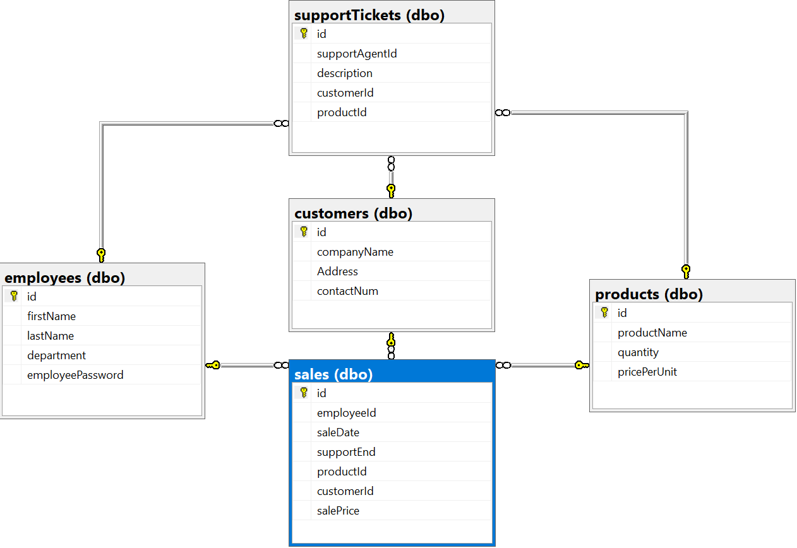
(Show diagram here)

Slide 4
Project Overview

Slide 5
Challenges – p.1(Yasser)

Slide 6
Sample solution code

Slide 7
Challenges – p.2(Chris)

Slide 8
Sample solution code

Slide 9
A specific solution (Yasser)
Explain how the solution works exactly

Slide 10
A specific solution (Chris)
Explain how the solution works exactly

Slide 11
What else was planned
(Printing, export, import)

Slide 12

Summary

